Slide 1
R Data Clinic
Ana Bento & Reni Kaul
Aug. 18. 2017

Slide 2
What is R?

Slide 3
R is a language and environment for statistical computing and graphics
Notes:
When I mention CRAN I will say this: is a network of ftp and web servers that store identical, up-to-date, versions of code and documentation and packages for R.

Slide 4
R is a language and environment for statistical computing and graphics
The official R home page: http://www.R-project.org
Notes:
When I mention CRAN I will say this: is a network of ftp and web servers that store identical, up-to-date, versions of code and documentation and packages for R.

Slide 5
R is a language and environment for statistical computing and graphics
The official R home page: http://www.R-project.org
You download it from CRAN: https://cran.r-project.org/
Notes:
When I mention CRAN I will say this: is a network of ftp and web servers that store identical, up-to-date, versions of code and documentation and packages for R.

Slide 6
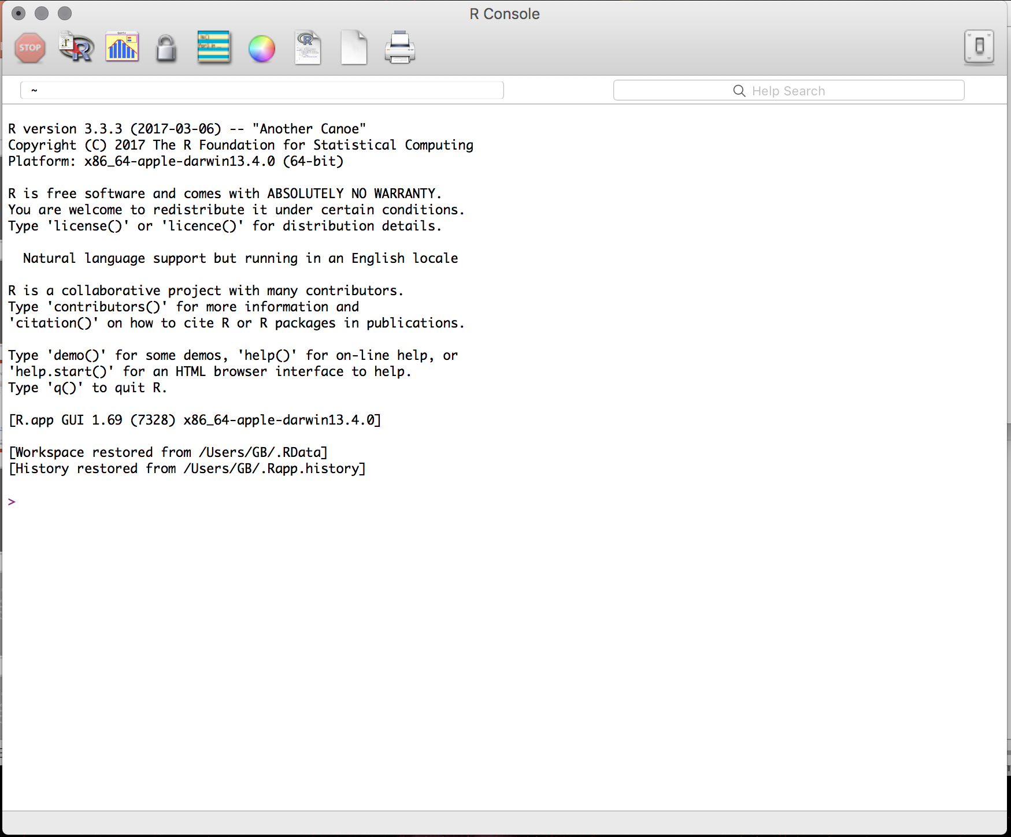
R is a language and environment for statistical computing and graphics
The official R home page: http://www.R-project.org
You download it from CRAN: https://cran.r-project.org/
The R system can be installed on, Windows, Mac or Linux
Notes:
When I mention CRAN I will say this: is a network of ftp and web servers that store identical, up-to-date, versions of code and documentation and packages for R.

Slide 7
Why R?

Slide 8
It’s free
Notes:
It's free!
Popularity -- we can show published papers with plots
Awesome power
can handle complex and large data
can easily program complex simulations
can be used on High Performance Computer Clusters * supports multicore task distribution* Flexibility* Great support * Packages vignettes, tutorials, free books * StackOverflow * R-Bloggers

Slide 9
It’s free
Popularity
Notes:
It's free!
Popularity -- we can show published papers with plots
Awesome power
can handle complex and large data
can easily program complex simulations
can be used on High Performance Computer Clusters * supports multicore task distribution* Flexibility* Great support * Packages vignettes, tutorials, free books * StackOverflow * R-Bloggers

Slide 10
It’s free
Popularity
Awesome power: can handle complex and large data
can easily program complex simulations
can be used on High Performance Computer Clusters
supports multicore task distribution
Notes:
It's free!
Popularity -- we can show published papers with plots
Awesome power
can handle complex and large data
can easily program complex simulations
can be used on High Performance Computer Clusters * supports multicore task distribution* Flexibility* Great support * Packages vignettes, tutorials, free books * StackOverflow * R-Bloggers

Slide 11
It’s free
Popularity
Awesome power: can handle complex and large data
can easily program complex simulations
can be used on High Performance Computer Clusters
supports multicore task distribution
Flexibility
Notes:
It's free!
Popularity -- we can show published papers with plots
Awesome power
can handle complex and large data
can easily program complex simulations
can be used on High Performance Computer Clusters * supports multicore task distribution* Flexibility* Great support * Packages vignettes, tutorials, free books * StackOverflow * R-Bloggers

Slide 12
It’s free
Popularity
Awesome power: can handle complex and large data
can easily program complex simulations
can be used on High Performance Computer Clusters
supports multicore task distribution
Flexibility
Great support: Packages; vignettes; tutorials; free books
StackOverflow; Rbloggers my two personal favorites!

Slide 13
R Studio

Slide 14
Using R is easier with RStudio
Notes:
It's free!
Popularity -- we can show published papers with plots
Awesome power
can handle complex and large data
can easily program complex simulations
can be used on High Performance Computer Clusters * supports multicore task distribution* Flexibility* Great support * Packages vignettes, tutorials, free books * StackOverflow * R-Bloggers

Slide 15
Using R is easier with RStudio
Cross platform application
Notes:
It's free!
Popularity -- we can show published papers with plots
Awesome power
can handle complex and large data
can easily program complex simulations
can be used on High Performance Computer Clusters * supports multicore task distribution* Flexibility* Great support * Packages vignettes, tutorials, free books * StackOverflow * R-Bloggers

Slide 16
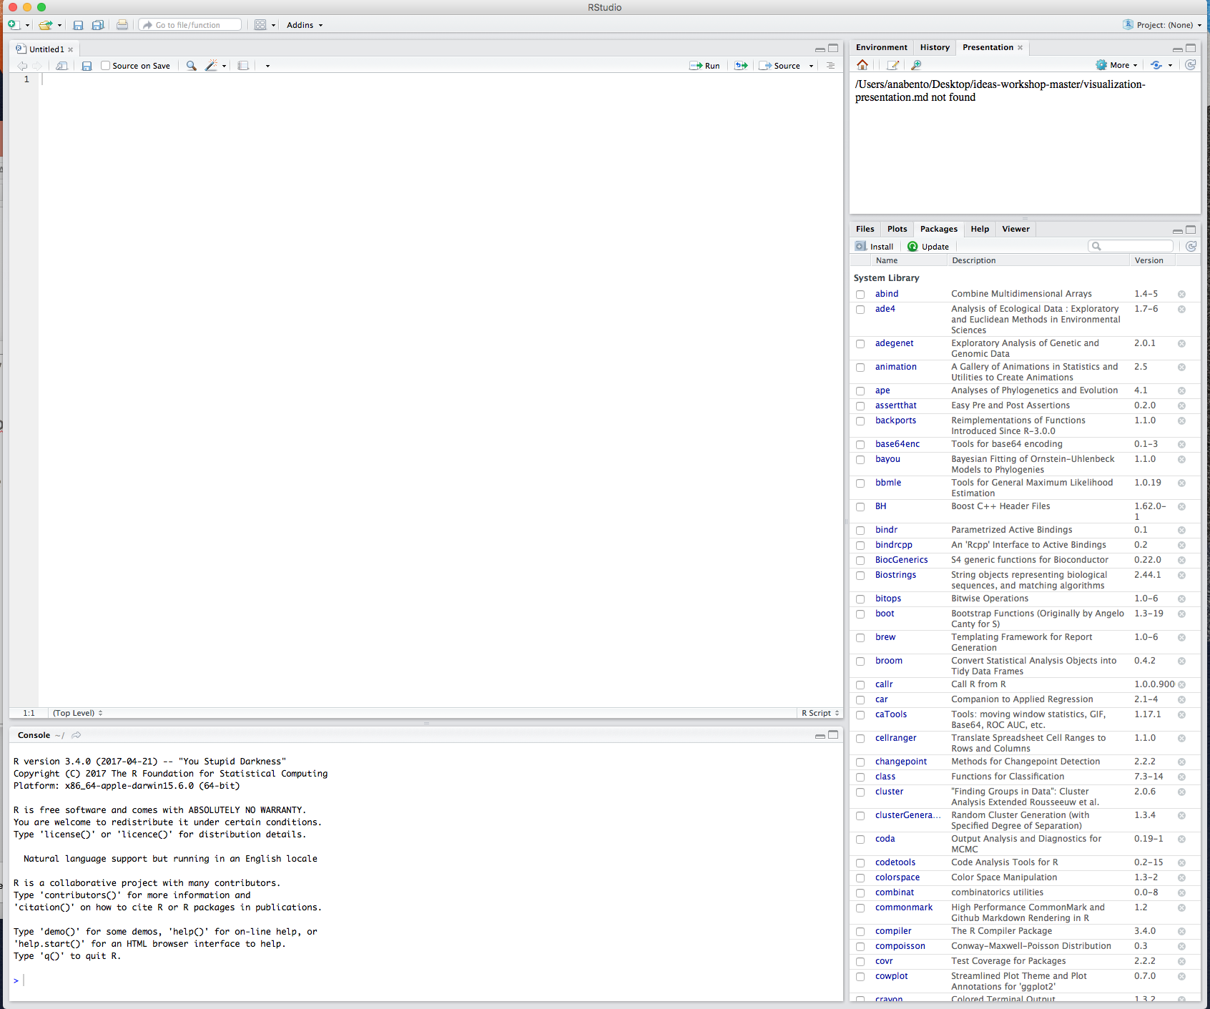
Using R is easier with RStudio
Cross platform application
Download it here: https://www.rstudio.com/products/rstudio/download
Notes:
It's free!
Popularity -- we can show published papers with plots
Awesome power
can handle complex and large data
can easily program complex simulations
can be used on High Performance Computer Clusters * supports multicore task distribution* Flexibility* Great support * Packages vignettes, tutorials, free books * StackOverflow * R-Bloggers

Slide 17
When we first start we have 3 panes: The console (the brain)
The environment & history
Files, plots packages help
The environment and history
Files, plots packages help
The console
Notes:
It's free!
Popularity -- we can show published papers with plots
Awesome power
can handle complex and large data
can easily program complex simulations
can be used on High Performance Computer Clusters * supports multicore task distribution* Flexibility* Great support * Packages vignettes, tutorials, free books * StackOverflow * R-Bloggers

Slide 18
R packages

Slide 19
R’s functionality is distributed among many packages
Notes:
It's free!
Popularity -- we can show published papers with plots
Awesome power
can handle complex and large data
can easily program complex simulations
can be used on High Performance Computer Clusters * supports multicore task distribution* Flexibility* Great support * Packages vignettes, tutorials, free books * StackOverflow * R-Bloggers

Slide 20
R’s functionality is distributed among many packages
e.g. stats package contains functions for statistical methods
Notes:
It's free!
Popularity -- we can show published papers with plots
Awesome power
can handle complex and large data
can easily program complex simulations
can be used on High Performance Computer Clusters * supports multicore task distribution* Flexibility* Great support * Packages vignettes, tutorials, free books * StackOverflow * R-Bloggers

Slide 21
R’s functionality is distributed among many packages
e.g. stats package contains functions for statistical methods
When you download R you get a set of base packages
Notes:
It's free!
Popularity -- we can show published papers with plots
Awesome power
can handle complex and large data
can easily program complex simulations
can be used on High Performance Computer Clusters * supports multicore task distribution* Flexibility* Great support * Packages vignettes, tutorials, free books * StackOverflow * R-Bloggers

Slide 22
R’s functionality is distributed among many packages
e.g. stats package contains functions for statistical methods
When you download R you get a set of base packages
You can download and install add-on packages in a variety of ways
Notes:
It's free!
Popularity -- we can show published papers with plots
Awesome power
can handle complex and large data
can easily program complex simulations
can be used on High Performance Computer Clusters * supports multicore task distribution* Flexibility* Great support * Packages vignettes, tutorials, free books * StackOverflow * R-Bloggers

Slide 23
R’s functionality is distributed among many packages
e.g. stats package contains functions for statistical methods
When you download R you get a set of base packages
You can download and install add-on packages in a variety of ways
Using the Packages tab in Rstudio
Notes:
It's free!
Popularity -- we can show published papers with plots
Awesome power
can handle complex and large data
can easily program complex simulations
can be used on High Performance Computer Clusters * supports multicore task distribution* Flexibility* Great support * Packages vignettes, tutorials, free books * StackOverflow * R-Bloggers

Slide 24
R’s functionality is distributed among many packages
e.g. stats package contains functions for statistical methods
When you download R you get a set of base packages
You can download and install add-on packages in a variety of ways
Using the Packages tab in Rstudio
Using the command line install.packages(“ggplot2”)
Notes:
It's free!
Popularity -- we can show published papers with plots
Awesome power
can handle complex and large data
can easily program complex simulations
can be used on High Performance Computer Clusters * supports multicore task distribution* Flexibility* Great support * Packages vignettes, tutorials, free books * StackOverflow * R-Bloggers

Slide 25
R’s functionality is distributed among many packages
e.g. stats package contains functions for statistical methods
When you download R you get a set of base packages
You can download and install add-on packages in a variety of ways
Using the Packages tab in Rstudio
Using the command line install.packages(“ggplot2”)
Using devtools install_github("hadley/ggplot2")

Slide 26
R Documentation

Slide 27
https://cran.r-project.org/web/packages/ggplot2/index.html
Notes:
It's free!
Popularity -- we can show published papers with plots
Awesome power
can handle complex and large data
can easily program complex simulations
can be used on High Performance Computer Clusters * supports multicore task distribution* Flexibility* Great support * Packages vignettes, tutorials, free books * StackOverflow * R-Bloggers

Slide 28
https://cran.r-project.org/web/packages/ggplot2/index.html
Reference manual pdf
Notes:
It's free!
Popularity -- we can show published papers with plots
Awesome power
can handle complex and large data
can easily program complex simulations
can be used on High Performance Computer Clusters * supports multicore task distribution* Flexibility* Great support * Packages vignettes, tutorials, free books * StackOverflow * R-Bloggers

Slide 29
https://cran.r-project.org/web/packages/ggplot2/index.html
Reference manual pdf
Vignettes
Notes:
It's free!
Popularity -- we can show published papers with plots
Awesome power
can handle complex and large data
can easily program complex simulations
can be used on High Performance Computer Clusters * supports multicore task distribution* Flexibility* Great support * Packages vignettes, tutorials, free books * StackOverflow * R-Bloggers

Slide 30
https://cran.r-project.org/web/packages/ggplot2/index.html
Reference manual pdf
Vignettes
https://www.rdocumentation.org/packages/ggplot2/versions/2.2.1
Notes:
It's free!
Popularity -- we can show published papers with plots
Awesome power
can handle complex and large data
can easily program complex simulations
can be used on High Performance Computer Clusters * supports multicore task distribution* Flexibility* Great support * Packages vignettes, tutorials, free books * StackOverflow * R-Bloggers

Slide 31
https://cran.r-project.org/web/packages/ggplot2/index.html
Reference manual pdf
Vignettes
https://www.rdocumentation.org/packages/ggplot2/versions/2.2.1
Using the console to search for info on a specific function e.g. ?read.csv
Notes:
It's free!
Popularity -- we can show published papers with plots
Awesome power
can handle complex and large data
can easily program complex simulations
can be used on High Performance Computer Clusters * supports multicore task distribution* Flexibility* Great support * Packages vignettes, tutorials, free books * StackOverflow * R-Bloggers

Slide 32
Goals

Slide 33
Simulating ODEs
Notes:
It's free!
Popularity -- we can show published papers with plots
Awesome power
can handle complex and large data
can easily program complex simulations
can be used on High Performance Computer Clusters * supports multicore task distribution* Flexibility* Great support * Packages vignettes, tutorials, free books * StackOverflow * R-Bloggers

Slide 34
Simulating ODEs
Writing functions
Notes:
It's free!
Popularity -- we can show published papers with plots
Awesome power
can handle complex and large data
can easily program complex simulations
can be used on High Performance Computer Clusters * supports multicore task distribution* Flexibility* Great support * Packages vignettes, tutorials, free books * StackOverflow * R-Bloggers

Slide 35
Simulating ODEs
Writing functions
Plotting results
Notes:
It's free!
Popularity -- we can show published papers with plots
Awesome power
can handle complex and large data
can easily program complex simulations
can be used on High Performance Computer Clusters * supports multicore task distribution* Flexibility* Great support * Packages vignettes, tutorials, free books * StackOverflow * R-Bloggers

Slide 36
Simulating ODEs
Writing functions
Plotting results
Calculating summary statistics
Notes:
It's free!
Popularity -- we can show published papers with plots
Awesome power
can handle complex and large data
can easily program complex simulations
can be used on High Performance Computer Clusters * supports multicore task distribution* Flexibility* Great support * Packages vignettes, tutorials, free books * StackOverflow * R-Bloggers

Slide 37
Today

Slide 38
Data Types
Vectors
Matrices
Factors
Data frames
Lists
Notes:
It's free!
Popularity -- we can show published papers with plots
Awesome power
can handle complex and large data
can easily program complex simulations
can be used on High Performance Computer Clusters * supports multicore task distribution* Flexibility* Great support * Packages vignettes, tutorials, free books * StackOverflow * R-Bloggers

Slide 39
Data Types
Vectors
Matrices
Factors
Data frames
Lists
Data Manipulation
Notes:
It's free!
Popularity -- we can show published papers with plots
Awesome power
can handle complex and large data
can easily program complex simulations
can be used on High Performance Computer Clusters * supports multicore task distribution* Flexibility* Great support * Packages vignettes, tutorials, free books * StackOverflow * R-Bloggers

Slide 40
Data Types
Vectors
Matrices
Factors
Data frames
Lists
Data Manipulation
Functions
examples of functions
loops
summary stats
Notes:
It's free!
Popularity -- we can show published papers with plots
Awesome power
can handle complex and large data
can easily program complex simulations
can be used on High Performance Computer Clusters * supports multicore task distribution* Flexibility* Great support * Packages vignettes, tutorials, free books * StackOverflow * R-Bloggers

Slide 41
Data Types
Vectors
Matrices
Factors
Data frames
Lists
Data Manipulation
Functions
examples of functions
loops
summary stats
Writing a script
Notes:
It's free!
Popularity -- we can show published papers with plots
Awesome power
can handle complex and large data
can easily program complex simulations
can be used on High Performance Computer Clusters * supports multicore task distribution* Flexibility* Great support * Packages vignettes, tutorials, free books * StackOverflow * R-Bloggers

Slide 42
Tomorrow

Slide 43
Recap script & scramble exercises
Data visualization
basic
ggplot
plottly (interactive plots)
Collaborative coding
Simulations
Notes:
It's free!
Popularity -- we can show published papers with plots
Awesome power
can handle complex and large data
can easily program complex simulations
can be used on High Performance Computer Clusters * supports multicore task distribution* Flexibility* Great support * Packages vignettes, tutorials, free books * StackOverflow * R-Bloggers

